Slide 1
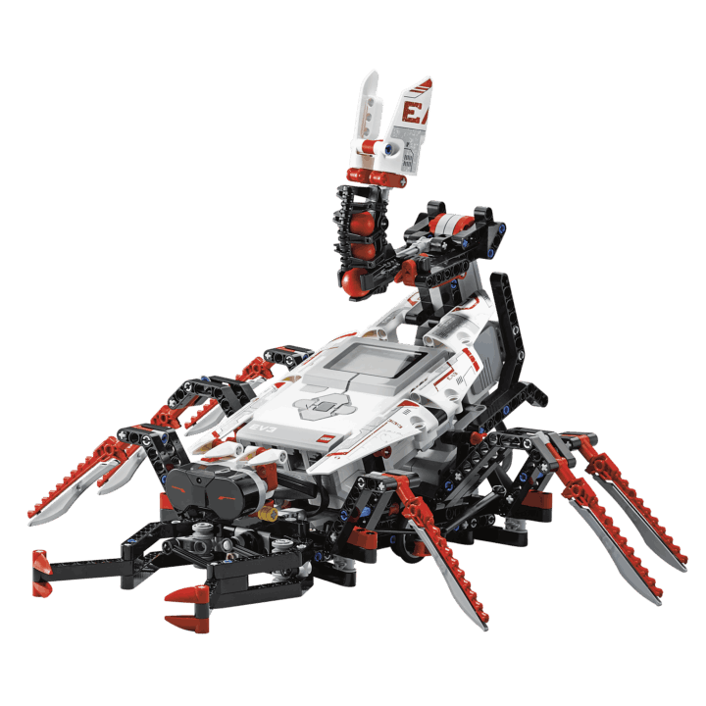
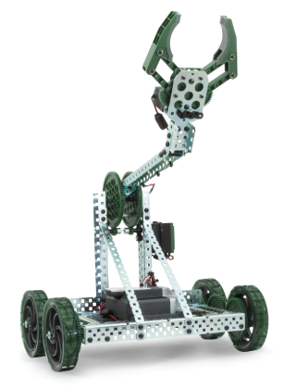
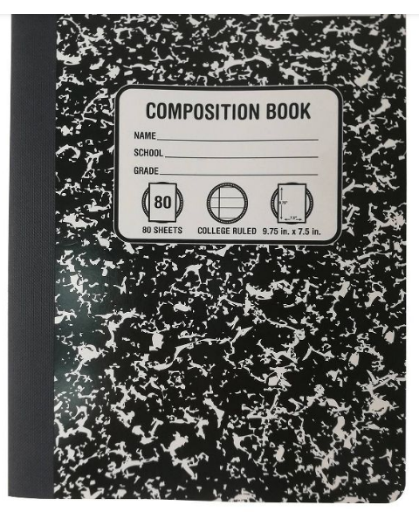
S.T.E.M. Robotics
Dr. Strickland
S.T.E.M. stands for Science, Technology, Engineering & Math.
We will be doing projects that involve ALL of these skills at once.
SYLLABUS:
1. We will be learning the Engineering Design Process About 1 - 2 weeks
(see the bulletin board to the right of the TV)
2. We will be doing projects that correspond to what our grade level is doing in science. About 1 - 2 weeks
3. We will use our skills to create robots and program their actions using coding. About 2 – 4 weeks
Projects will combine our knowledge, critical thinking & teamwork.
All units will start with worksheets or video quizzes, so we can learn the background knowledge.
BRING: A pencil or 2 every day. Colored Pencils a Composition notebook (it will stay in class)
Consider bringing extra of these for kids that don’t bring them .
To be successful in my class:
1. Sit in your assigned seat.
2. Keep your phone in your bag.
3. Be completely silent while I'm talking to the class- never interrupting - then I'll let you talk a you want while you're doing your classwork.
4. Mind Your Own Business!! Don’t yell out a tattle. If it’s important, walk up & tell the teacher.
All of the work is designed to be completed in class, no HW unless you waste time or goof off.
You can ALWAYS work with your neighbors, except for quizzes.
Because you can work together, there's no excuse for not finishing
Students: YOU are in charge as to whether we do worksheets or other simple activities, or do pdon’t do their work, waste materials on easy projects, we will NOT be getting rojects and robots. If students goof off, play, run around the room, out the expensive and fragile robot kits. It could be the whole class that continues to do papers and simple assignments, or the class may get divided. Some do Robots, some do worksheets. YOU are in charge!! It’ up to YOU!

